Slide 1
Emerging technologies (19IS5DCEMT) DEVOPS PROJECT
TOPIC : EVENT MANAGEMENT SYSTEM WEBSITE
Scrum Master 1DS19IS052 Kruthi R Aithal
Product Owner 1DS19IS039 Disha D
Team members
1DS19IS011 Aishwarya J Annigeri
1DS19IS013 Akriti Kumari
1DS19IS017 Anitha P
1DS19IS020 Apoorva S V
1DS19IS025 Avani K S
1DS19IS042 Gowthami Holla K S
1DS19IS054 Manasa B
SLIDE 1 OF 36

Slide 2
Requirements
In Scope Requirements :
Venue and event booking
List of venue, events, caterers and decorators
Registration for new users
Login of existing user
Booking of events
Providing review
Out of Scope Requirements :
Only user interface , i.e., admin functions are not included
Venues only in Bangalore, i.e., provide service only in limited areas
No payment options
SLIDE 2 OF 36

Slide 3
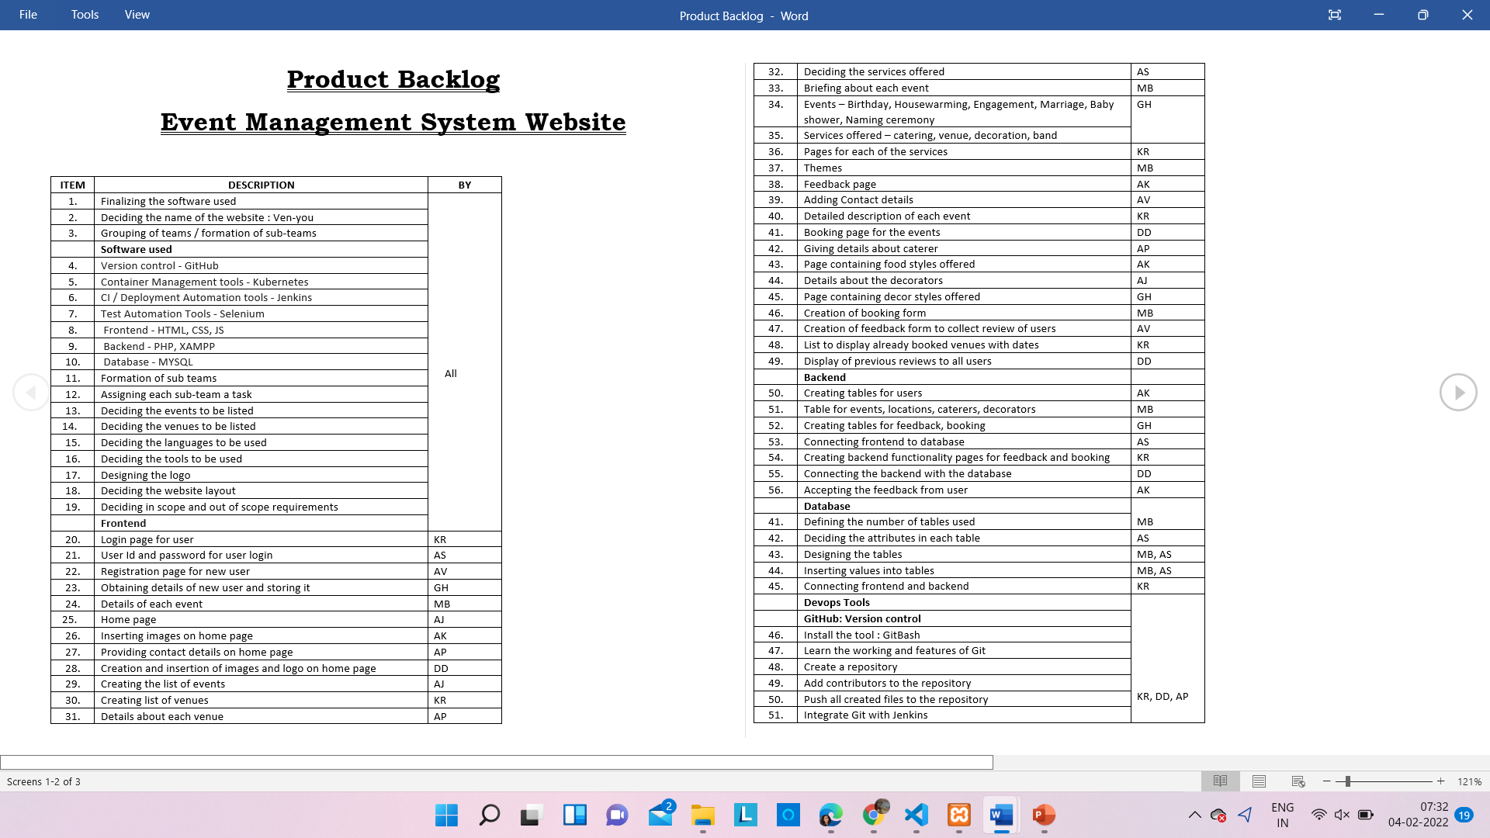
PRODUCT BACKLOG :
SLIDE 3 OF 36

Slide 4
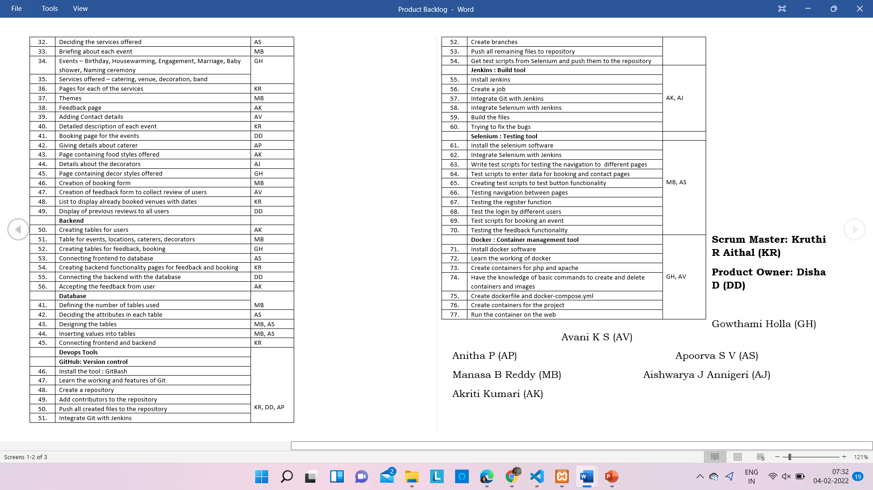
SLIDE 4 OF 36

Slide 5
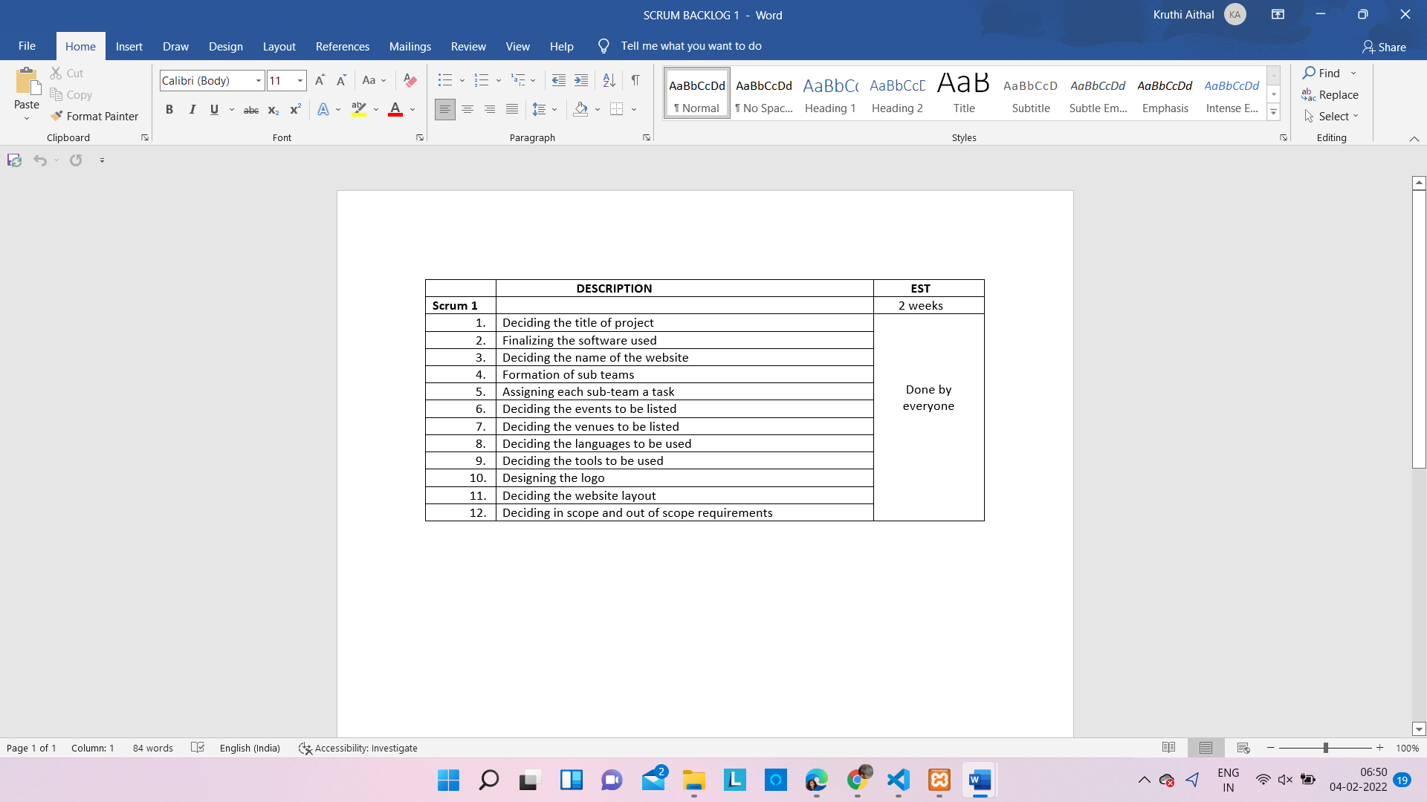
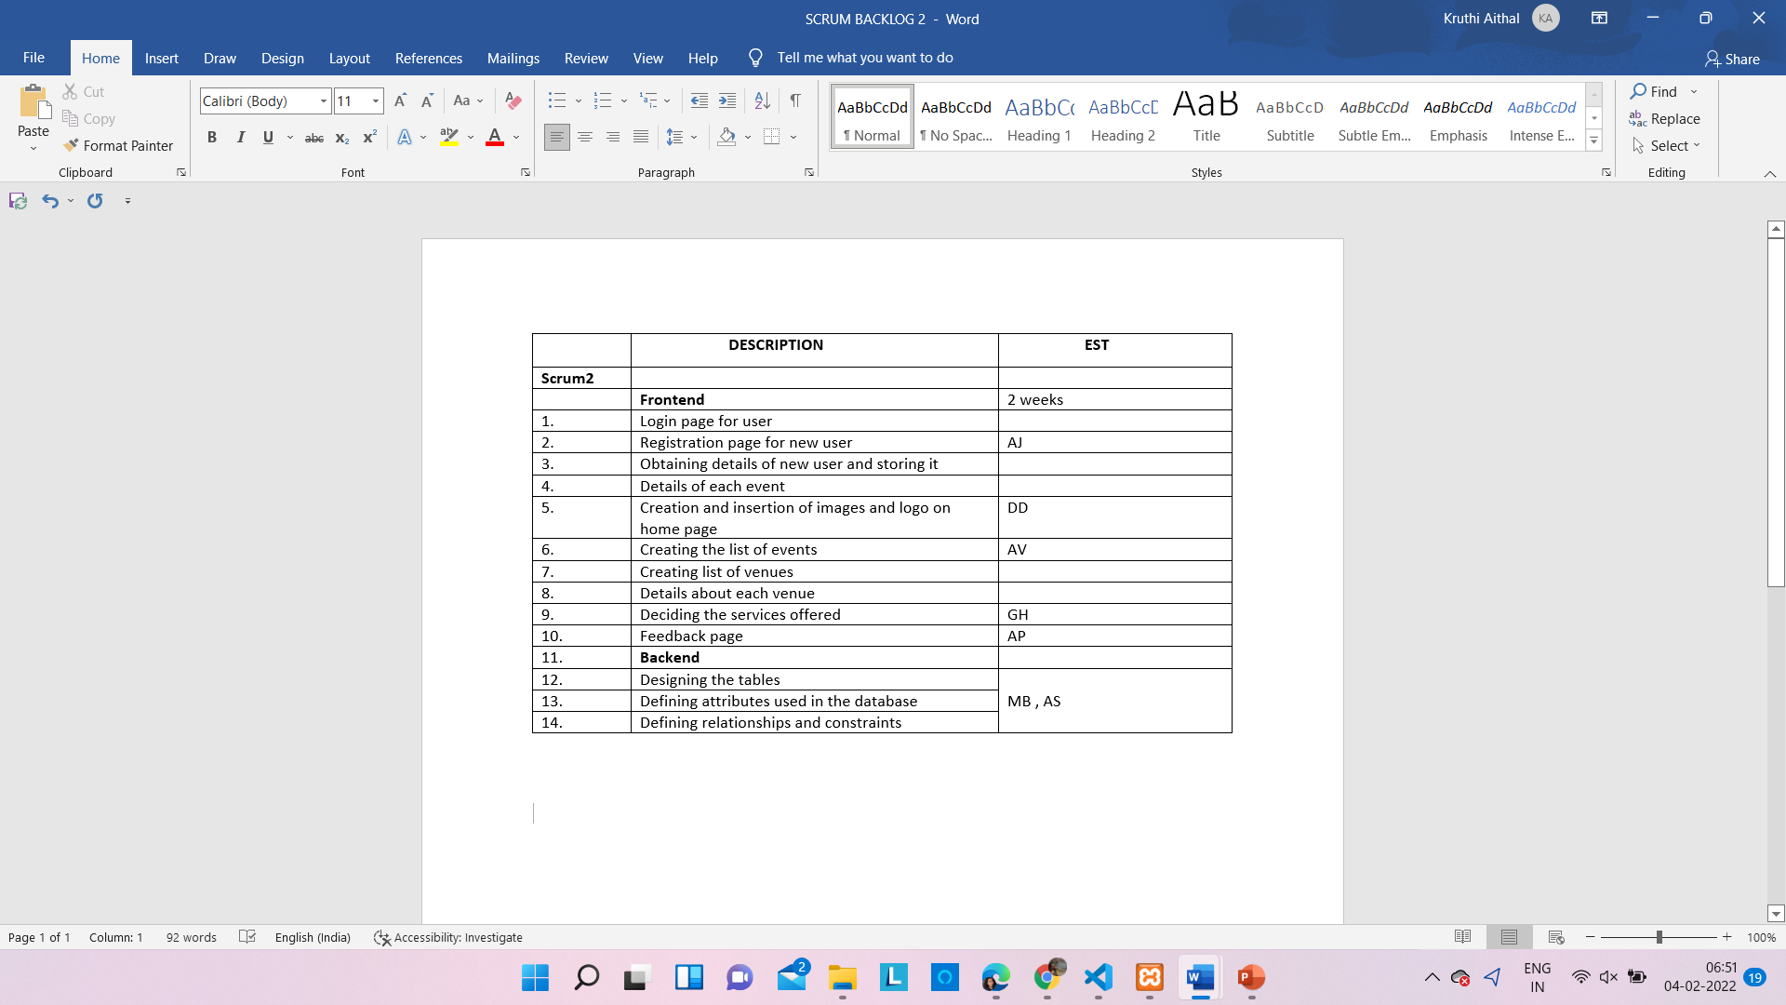
SCRUM BACKLOGS :
Scrum duration : 2 weeks
SCRUM 1
SCRUM 2
SLIDE 5 OF 36

Slide 6
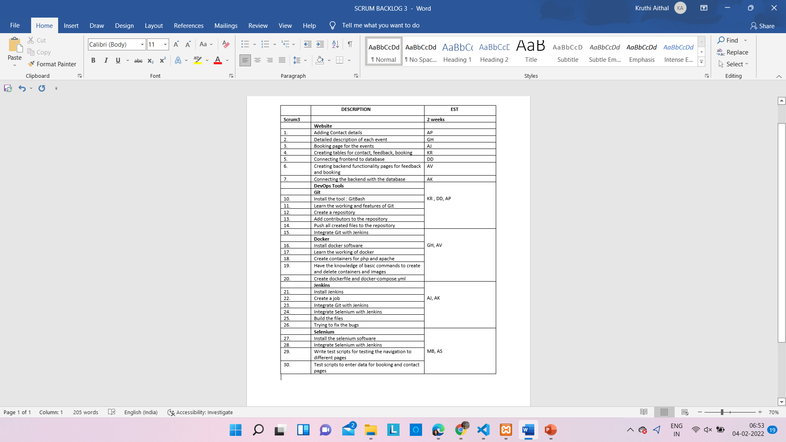
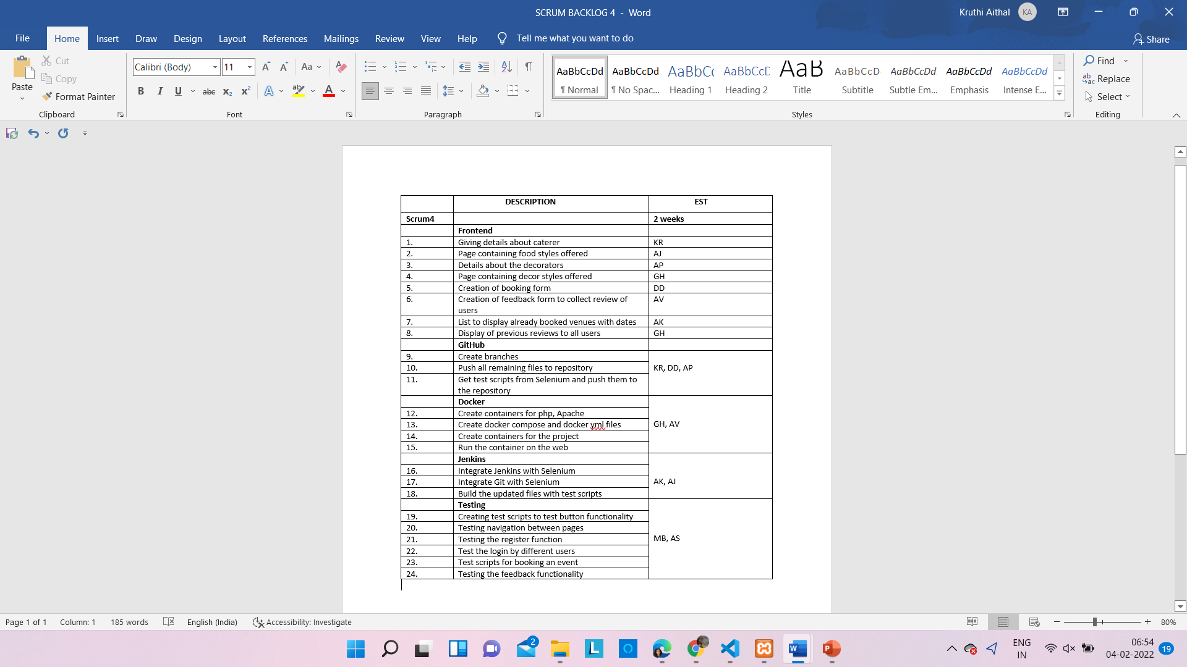
SCRUM 3
SCRUM 4
SLIDE 6 OF 36

Slide 7
SUB TEAMS FOR DEVOPS TOOLS :
Version Control Tools – Git and GitHub
Sub Team handling the tool : Anitha P, Disha D, Kruthi R Aithal
Container Management Tool - Docker
Sub Team handling the tool : Avani K , Gowthami Holla K S
CI/Deployment Tool - Jenkins
Sub Team handling the tool : Aishwarya J Annigeri , Akriti Kumari
Testing Tool – Selenium
Sub Team handling the tool : Apoorva S V , Manasa B
SLIDE 7 OF 36

Slide 8
Front-end
We are using HTML,CSS and JavaScript to implement the front-end part of our website.
PHP is also being used in this context.
Front-end includes :
Home page
User login page
Registration page for new users
Venue page
Event page
Caterers page
Decorations page
Feedback page
SLIDE 8 OF 36

Slide 9
STATUS : All frontend functionalities are completed.
Home page along with logo is designed.
Login page for user that accepts user details and verifies them with the
values in the database is created.
Login page for admin, which enables admin to access all
details of the events and modify them is in progress.
Registration page for new user by accepting user information and storing it
in the database for future references is finished.
Contact page is also completed.
The pages containing list of events and venues along with their details are done.
The feedback page is done.
Contact details are also provided.
SLIDE 9 OF 36

Slide 10
BACK-END
We are making use of PHP for the back-end.
For designing and implementing the database functions, we are using MySQL.
XAMPP is being used to run the website on the localhost.
Backend functions include:
Designing database functions
Designing tables
Connecting frontend and backend to database
Display of already booked venues with dates
Display of previous review by other users
Status : All backend tasks are completed.
SLIDE 10 OF 36

Slide 11

Version Control Tools
We are making use of Git and GitHub as Version Control Tools.
Git is a version control system that lets us manage and keep track
of our source code history.
GitHub is a cloud-based hosting service that lets us manage Git repositories.
If there are open-source projects that use Git, then GitHub is designed
to help in managing them.
Benefits :
Easier to contribute to open source projects
Documentation
Showcase your work
Track changes in your code across versions.
Integrate options
SLIDE 11 OF 36

Slide 12
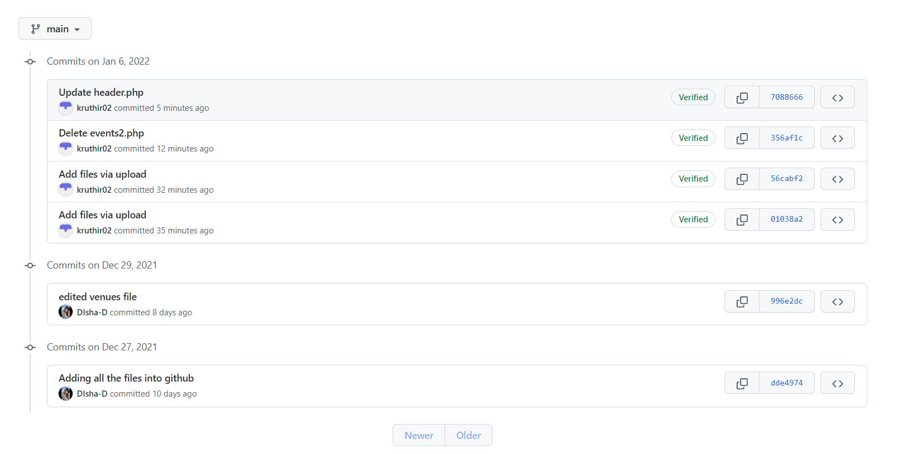
Status :
Installed Git Bash
Learnt the features and usage of Git
Created branches
Pushed and committed all files to the remote repository
SLIDE 12 OF 36

Slide 13

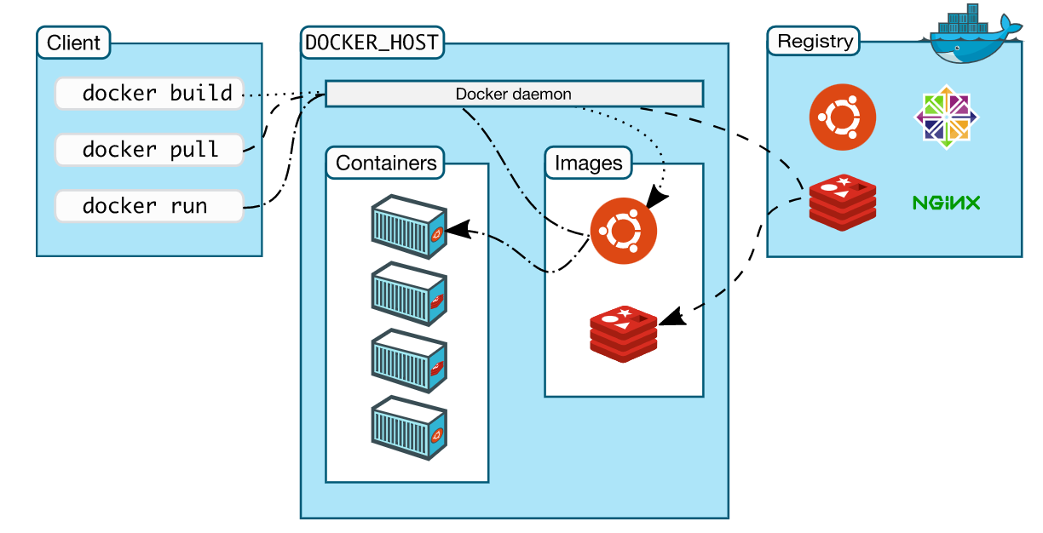
Container Management Tool
Docker is being used as Container Management tool.
Docker is an open platform for developing, shipping, and running applications. Docker enables you to separate your applications from your infrastructure so you can deliver software quickly. With Docker, you can manage your infrastructure in the same ways you manage your applications.
Benefits :
Portability and flexibility
Increased productivity
Multi-cloud capacity
Open source
SLIDE 13 OF 36

Slide 14
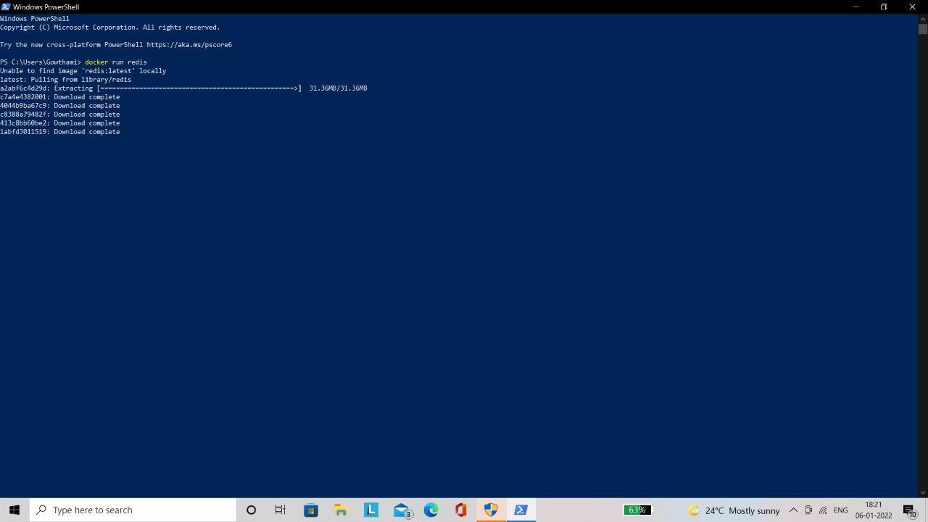
Status :
Docker containers are created for php and apache.
Docker compose and docker.yml files are created.
The container is running successfully.
SLIDE 14 OF 36

Slide 15

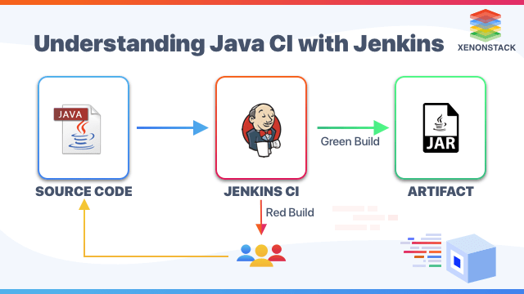
CI/Deployment Tool
We are making use of Jenkins for Deployment.
Jenkins is an open-source server that is written entirely in Java. It lets you execute a series of actions to achieve the continuous integration process, that too in an automated fashion.
Benefits:
Open source and user friendly
Easily Configurable
Platform Independent
SLIDE 15 OF 36

Slide 16
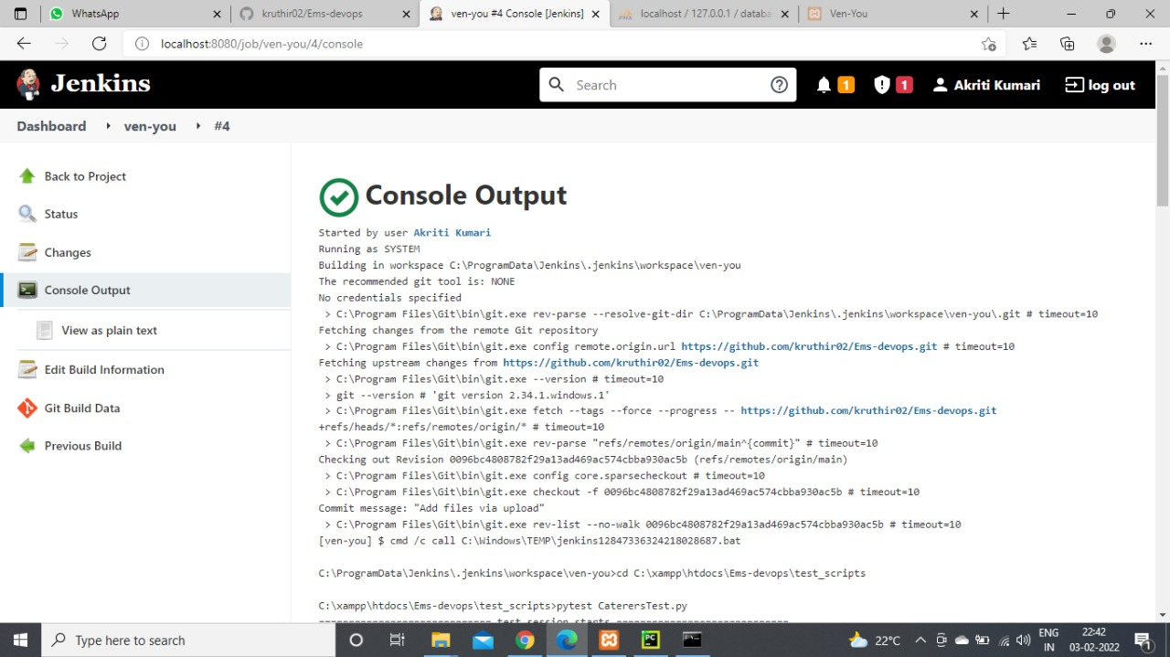
Status :
Integrated Jenkins with Git and Selenium
Received test scripts from Selenium and built them.
All the files are building successfully.
SLIDE 16 OF 36

Slide 17

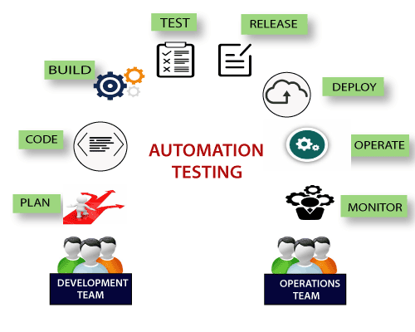
Testing Tool
The testing tool we are using is Selenium.
Selenium is an open-source tool that automates web browsers. It provides
a single interface that lets you write test scripts in various programming
languages.
Benefits :
Open source software
Supports multiple programming languages
Supports almost every OS
Supports parallel test execution
Supports multiple browsers
Provides support for frameworks.
SLIDE 17 OF 25

Slide 18
Status :
Test scripts written for login functionality.
Test scripts for checking navigation between pages.
Button testing
Test scripts to enter booking and feedback details.
All test scripts are working successfully.
SLIDE 18 OF 36

Slide 19
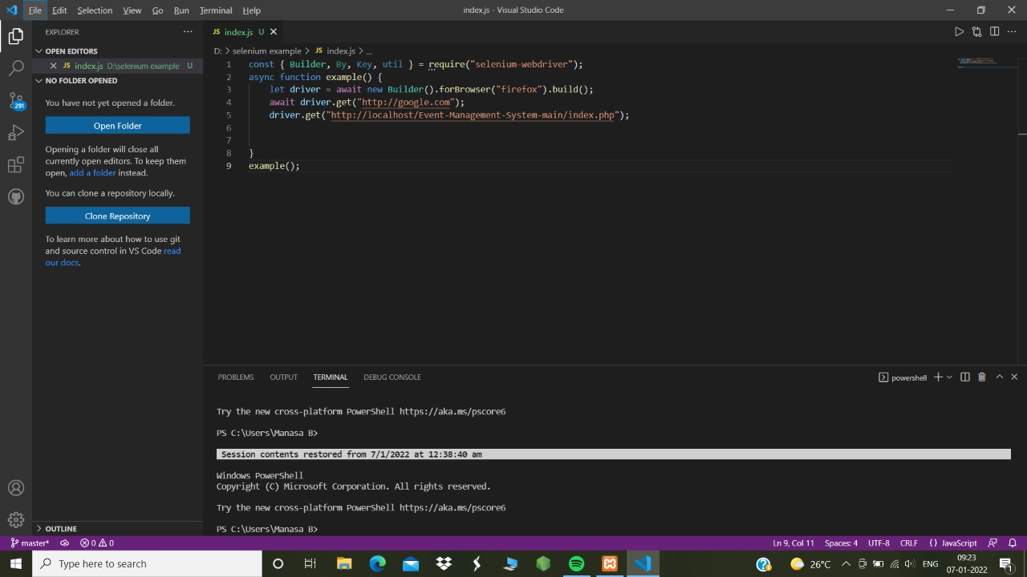
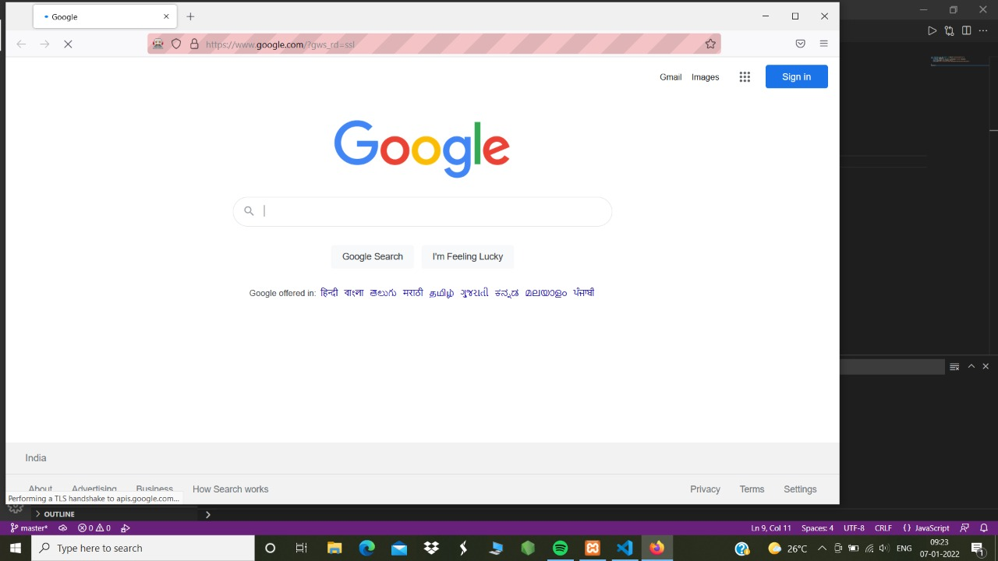
Selenium testing code for login page
SLIDE 19 OF 36

Slide 20
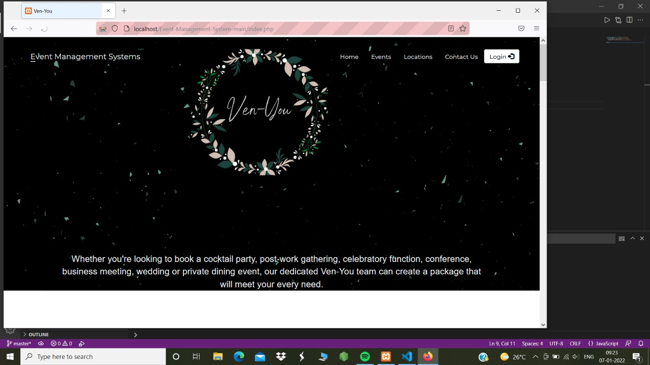
Output of Selenium: testing the login page
SLIDE 20 OF 36

Slide 21
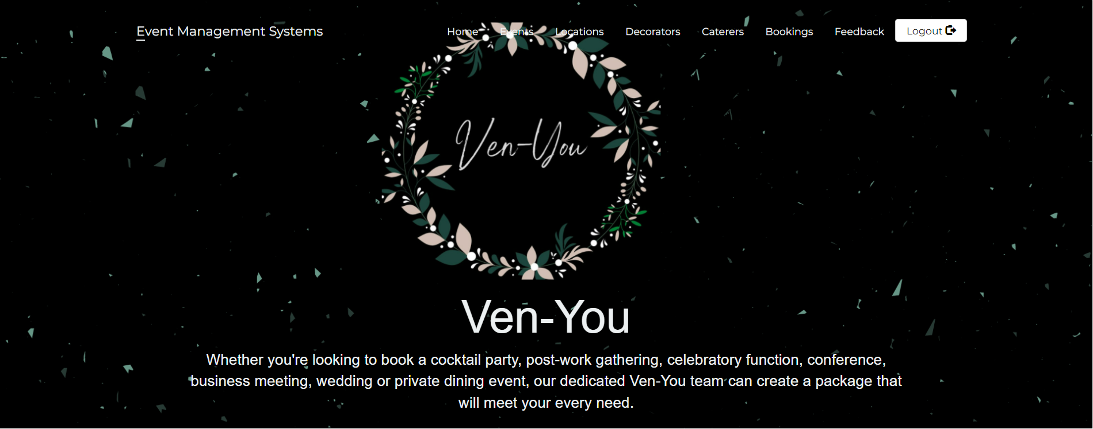
Home Page
SLIDE 21 OF 36

Slide 22
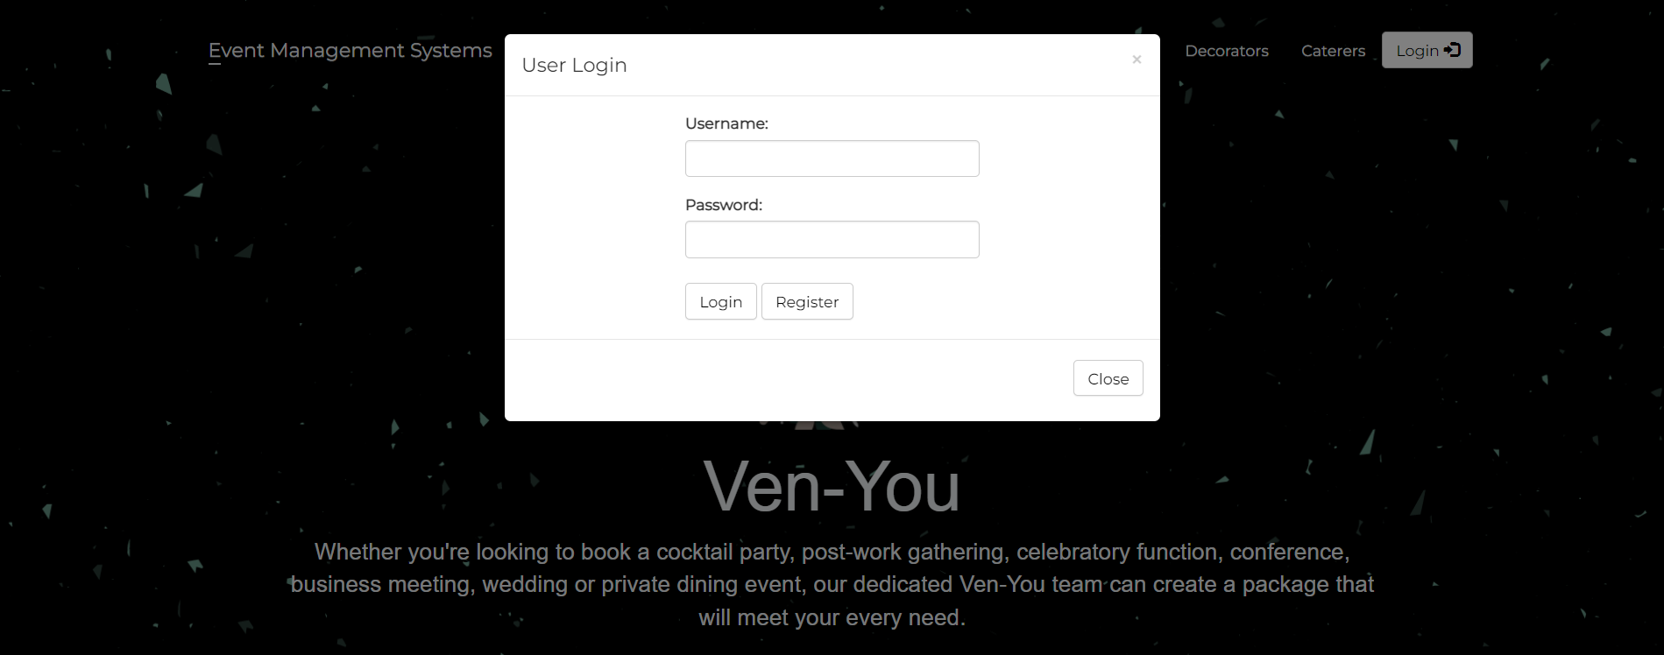
Existing user login page
SLIDE 22 OF 36

Slide 23
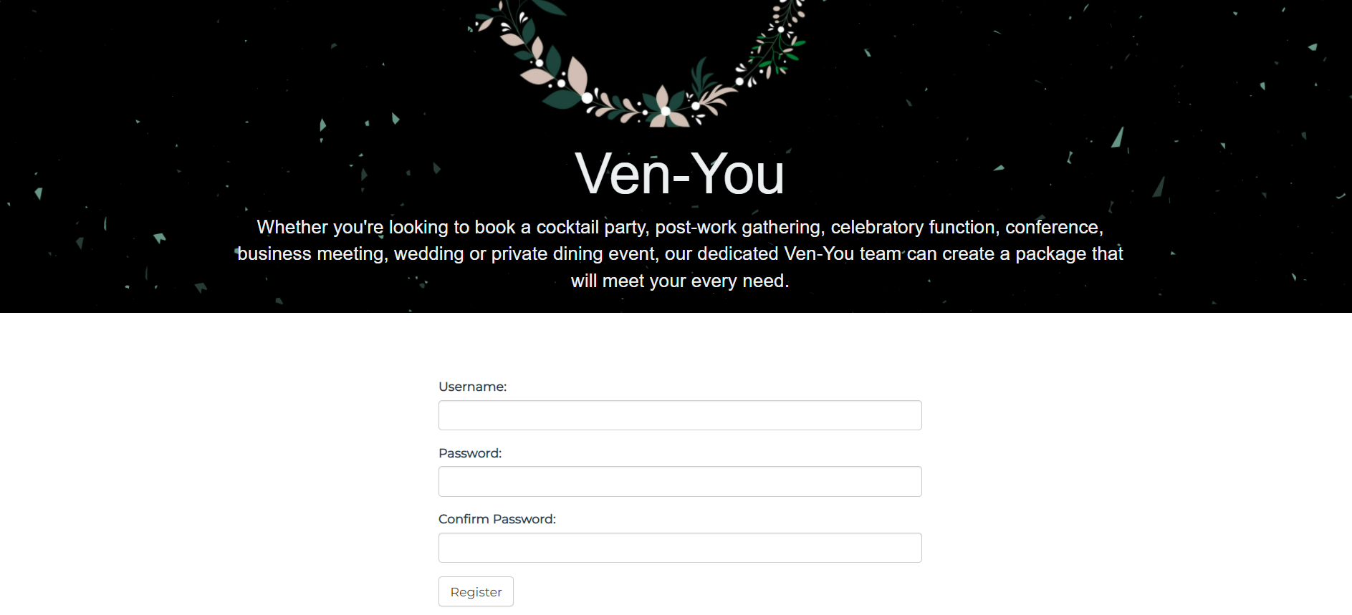
New user registration page
SLIDE 23 OF 36

Slide 24
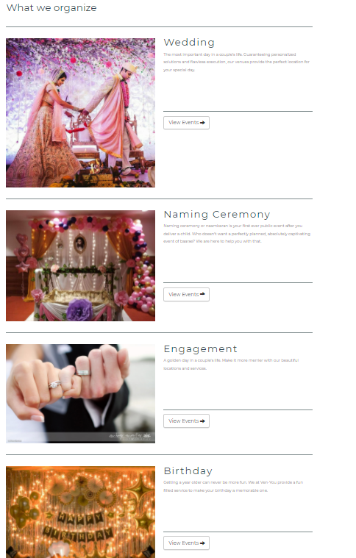
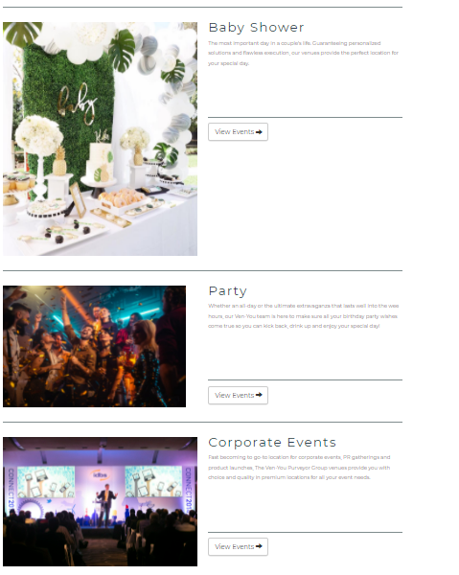
Events List
SLIDE 24 OF 36

Slide 25
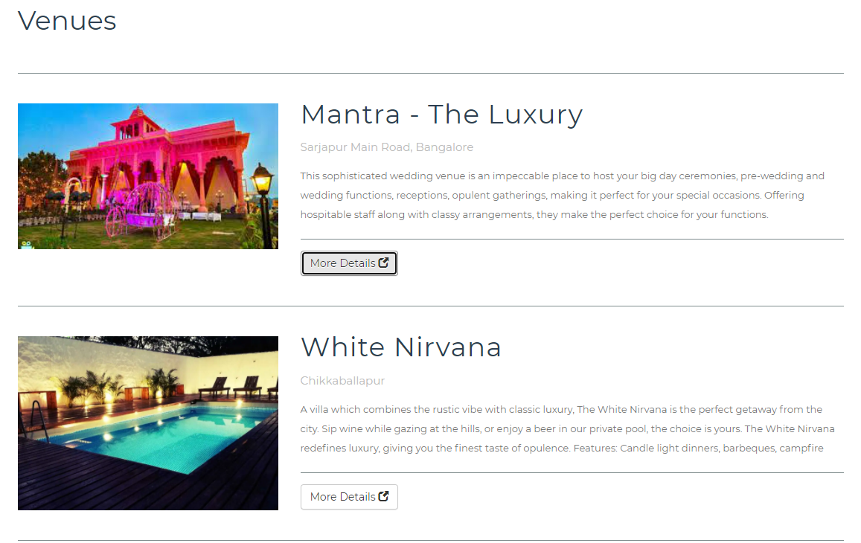
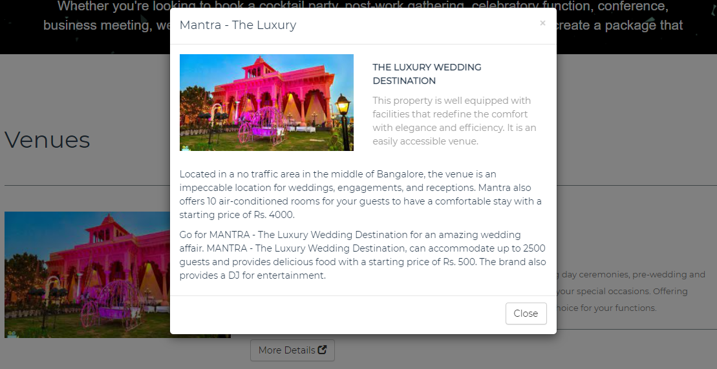
Venues List
SLIDE 25 OF 36

Slide 26
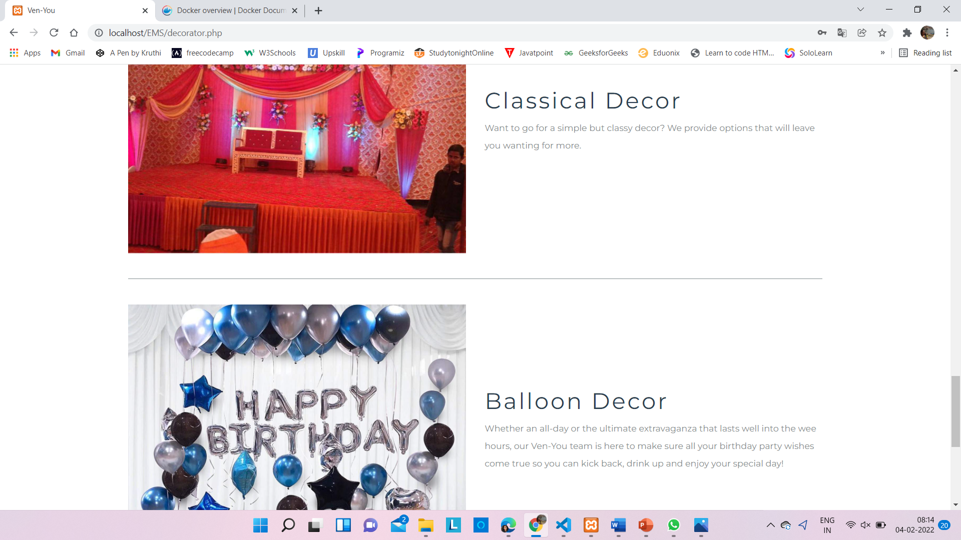
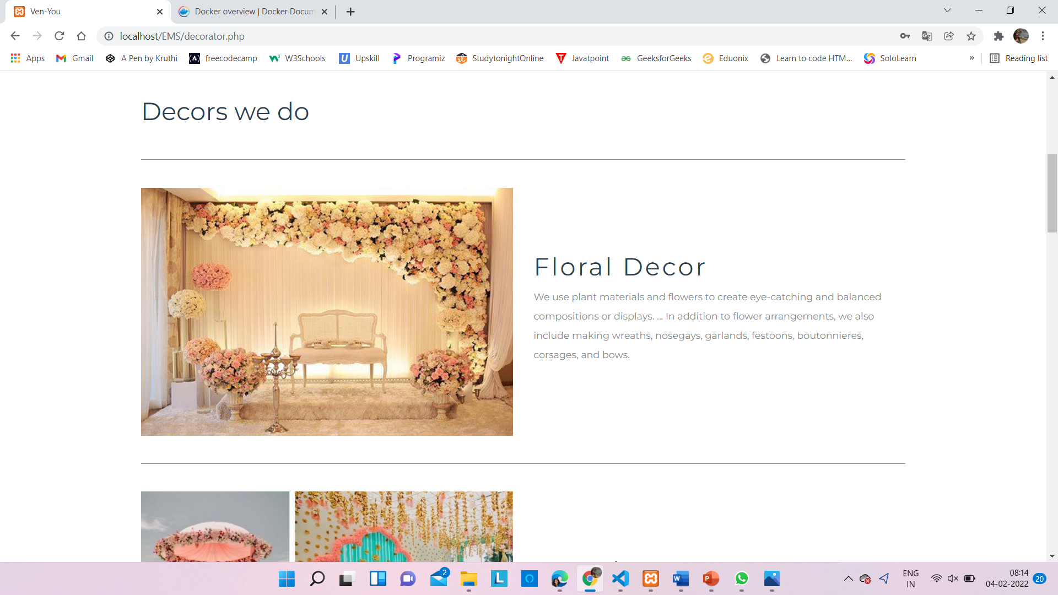
Décors offered
SLIDE 26 OF 36

Slide 27
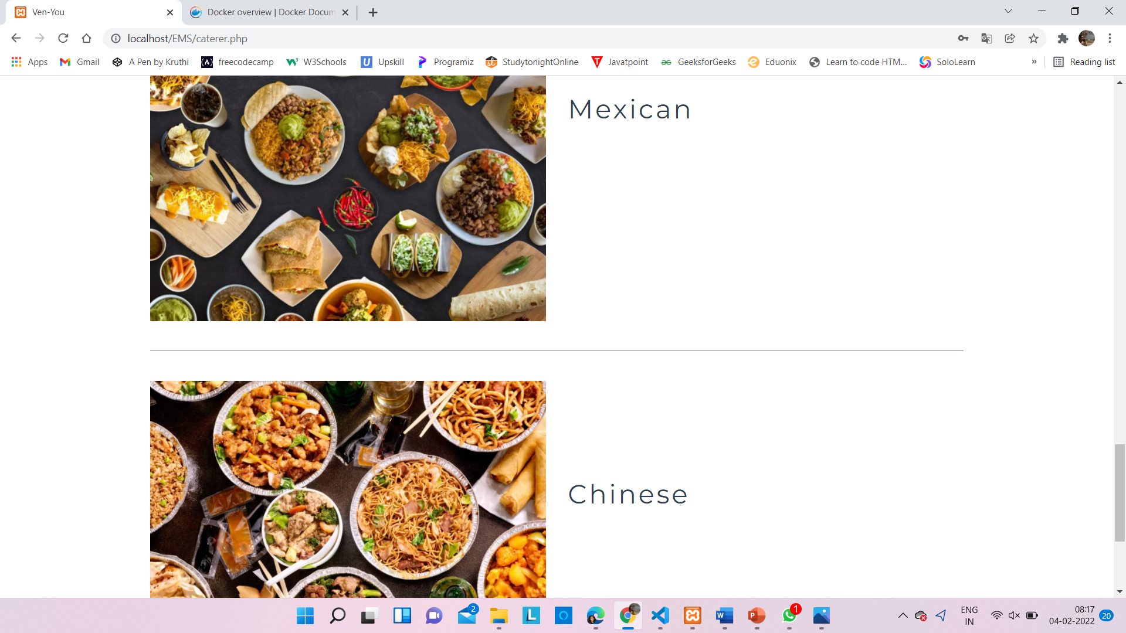
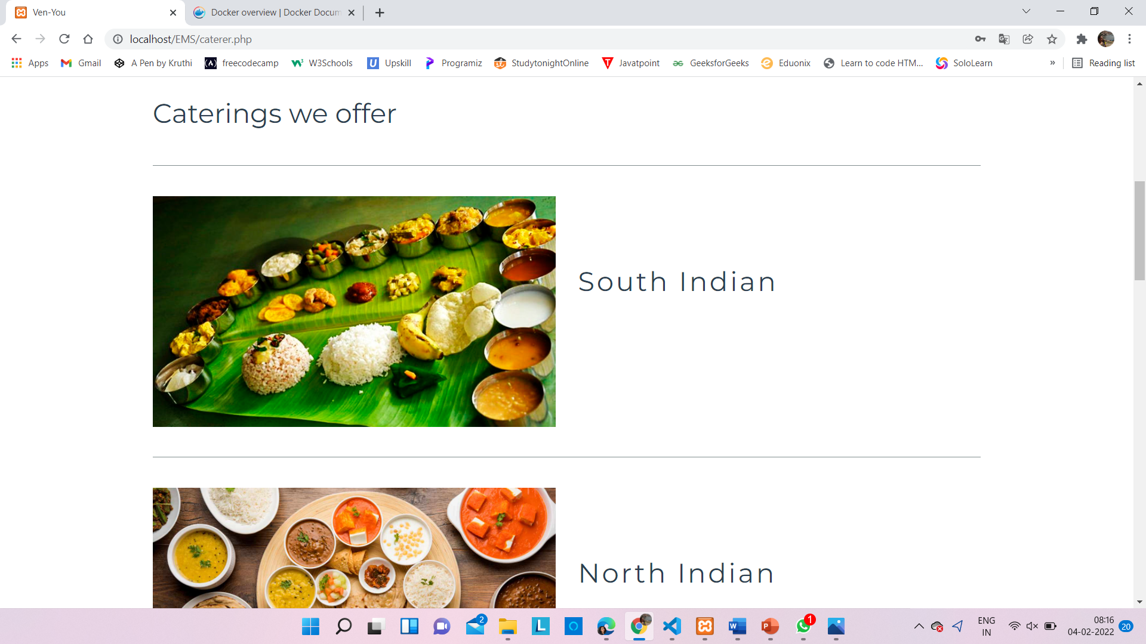
Caterings offered
SLIDE 27 OF 36

Slide 28
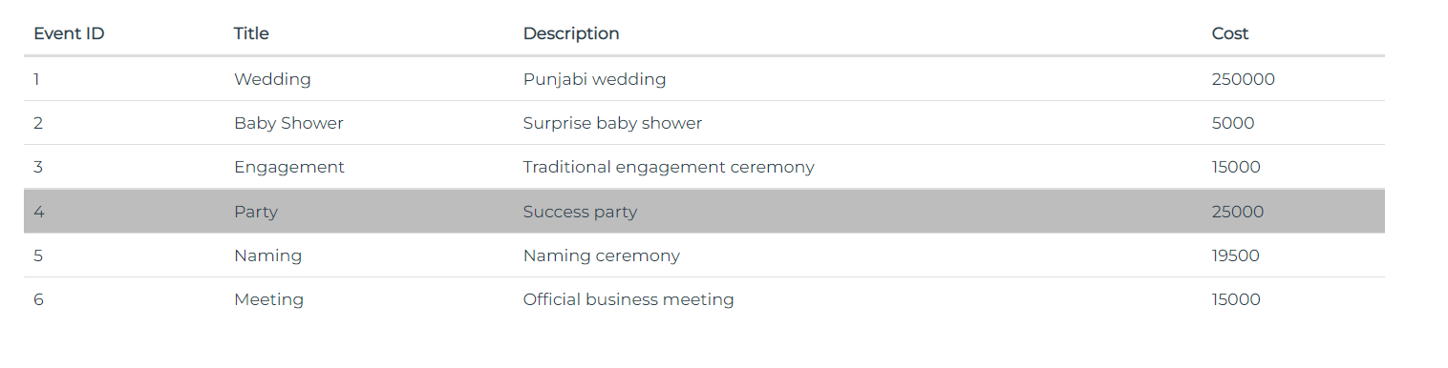
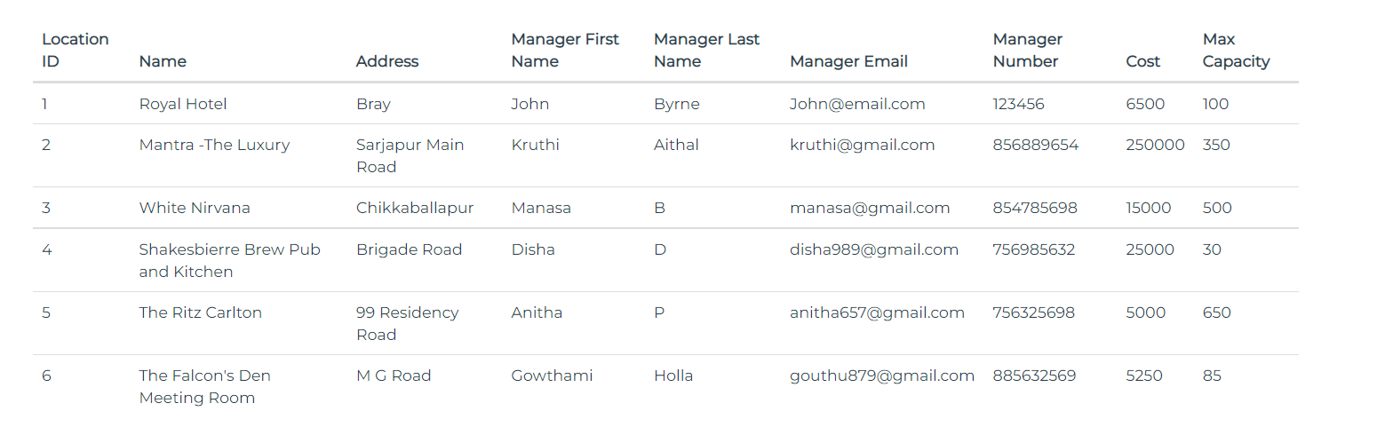
Display of events and locations
SLIDE 28 OF 36

Slide 29
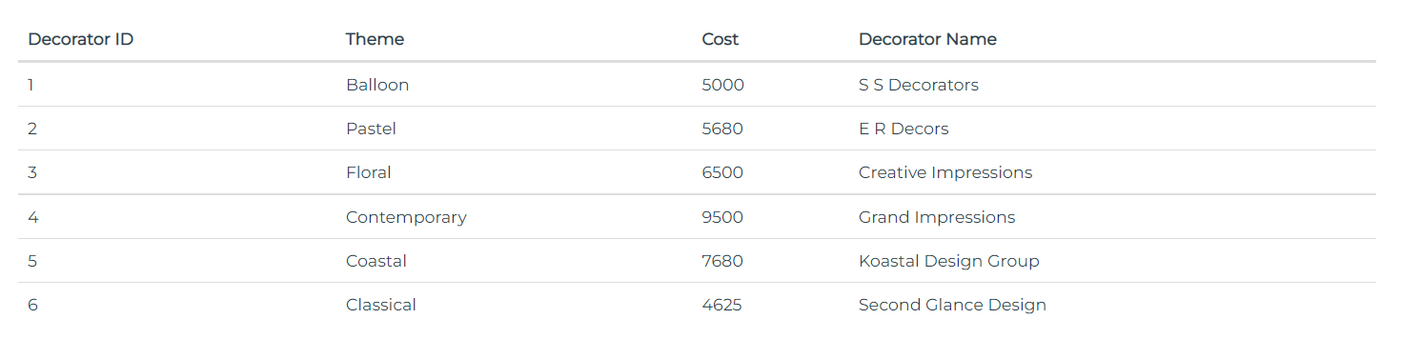
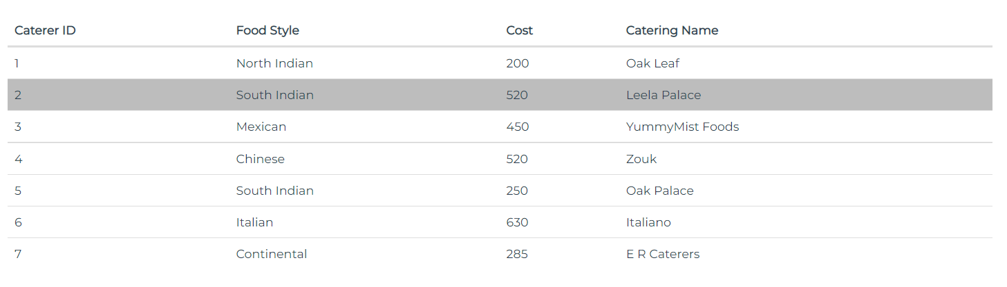
Decorators and caterers information
SLIDE 29 OF 36

Slide 30
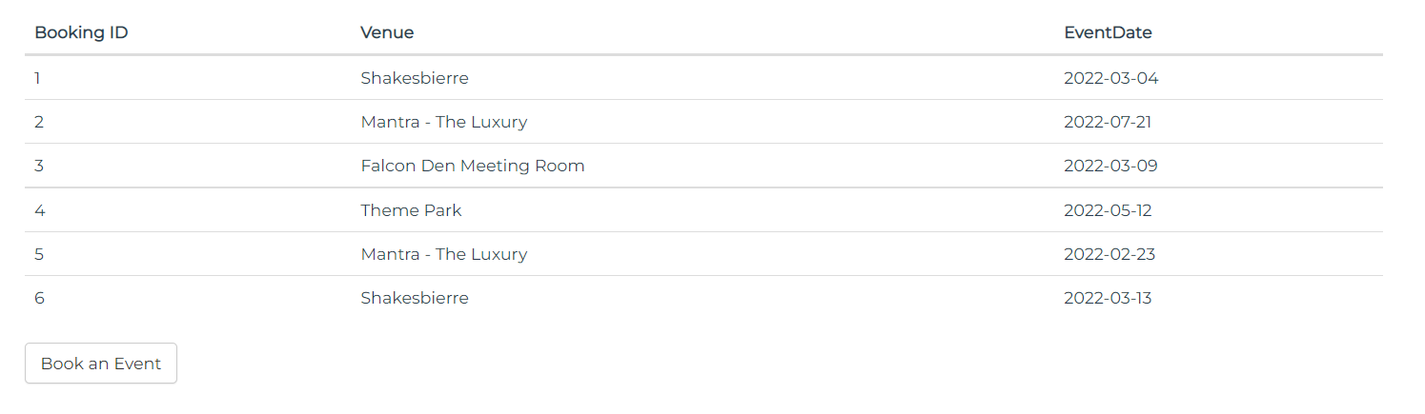
Booking list
SLIDE 30 OF 36

Slide 31
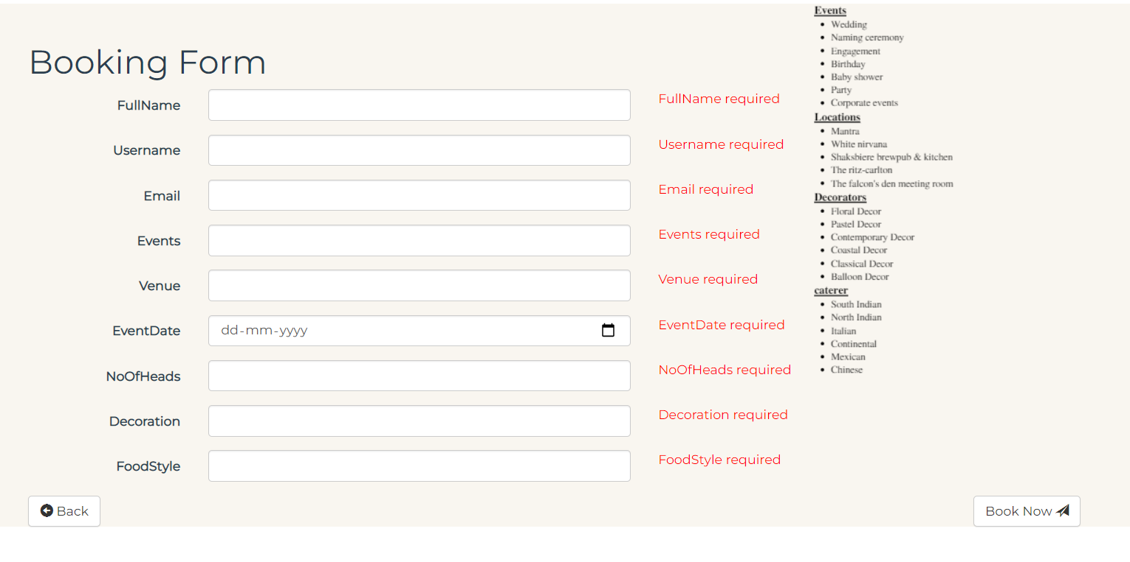
Booking Form
SLIDE 31 OF 36

Slide 32
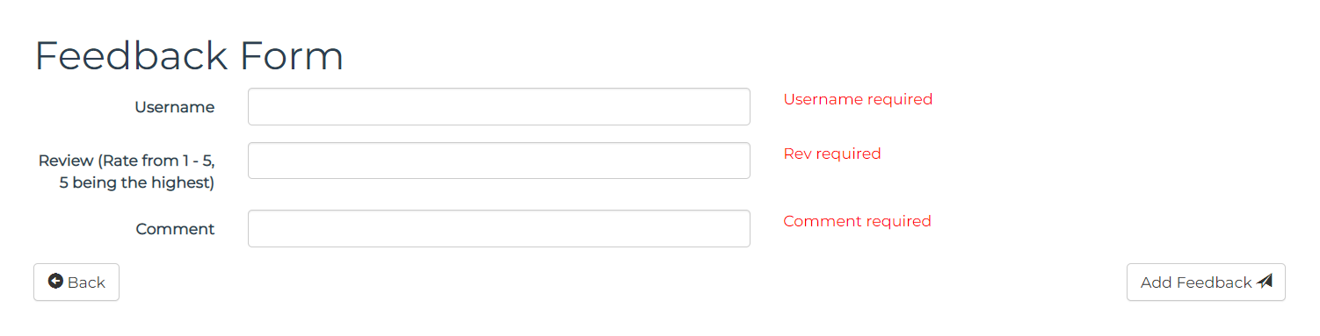
Feedback form
SLIDE 32 OF 36

Slide 33
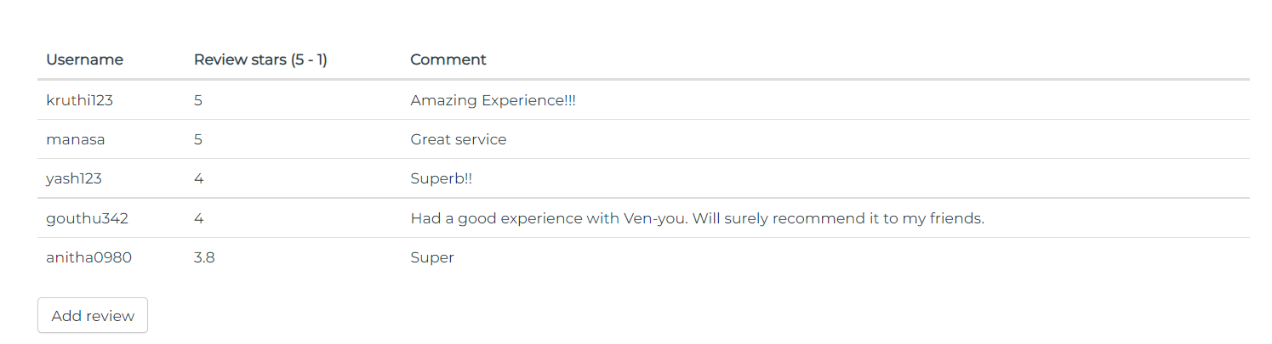
Display of review by other users
SLIDE 33 OF 36

Slide 34

Footer
SLIDE 34 OF 36

Slide 35
Velocity Metrics
SLIDE 35 OF 36

Slide 36
THANK YOU!
SLIDE 36 OF 36

